Slide 1
Linux Kernel Architecture
A Deep Dive into the Core of the OS

Slide 2
1. User Space (Applications & glibc):
• Contains user apps and the GNU C Library (glibc).
• glibc acts as the primary wrapper for system calls.
2. System Call Interface (SCI):
• The gatekeeper. It transitions requests from User Space to Kernel Space.
• Ensures security and provides a stable API for developers.
3. Kernel Space (The Engine):
• The 'Main Kernel' manages scheduling, memory, and filesystems.
• 'Arch-Dependent Code' optimizes the kernel for specific CPUs (x86, ARM).
4. Hardware Platform:
• The physical layer (CPU, RAM, Disk, NIC).
• Controlled by the kernel via Device Drivers.

Slide 3
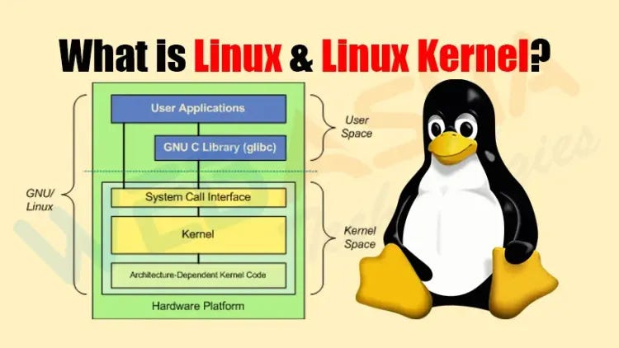

Slide 4
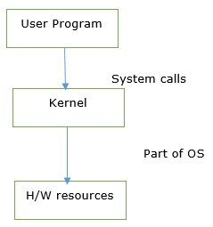
Architectural Breakdown: User vs. Kernel Space
SYSTEM ARCHITECTURE DETAILS:
• TRAP MECHANISM: When glibc executes a System Call, it triggers a 'Software Interrupt' (Trap), forcing the CPU to switch from Ring 3 (User) to Ring 0 (Kernel) mode.
• MONOLITHIC DESIGN: Unlike Microkernels, Linux runs the Scheduler, VFS, and Network Stack within a single address space to eliminate IPC overhead and boost speed.
• ARCH-DEPENDENT LAYER: This is the 'Hardware Abstraction Layer' (HAL). It contains assembly code specific to CPUs (like x86_64 or ARM), allowing the core kernel to remain portable.
• GLIBC WRAPPER: Applications don't talk to the kernel; they talk to glibc. This ensures that if the kernel API changes, the application code doesn't have to.

Slide 5
Process Scheduler
• Manages CPU time for all processes.
• Uses the Completely Fair Scheduler (CFS).
• Supports Preemption and Multi-core scalability.

Slide 6
Virtual File System (VFS)
• An abstraction layer for storage.
• Supports multiple formats (ext4, XFS, Btrfs).
• Standardizes 'read/write' operations for applications.

Slide 7
Network Stack
• Implements TCP/IP and other protocols.
• Uses a socket-based API for communication.
• Interfaces directly with Network Interface Cards (NICs).

